Slide 1
Logistic Regression

Slide 2
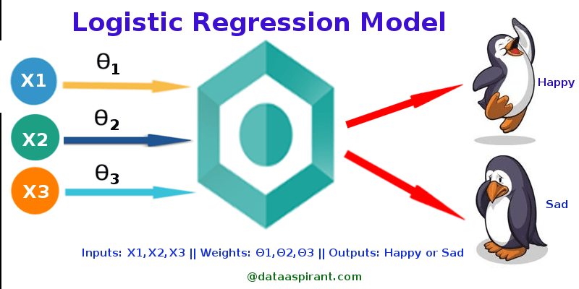

Slide 3
Logistic regression is a statistical method for predicting binary classes. The outcome or target variable is dichotomous in nature. Dichotomous means there are only two possible classes. For example, it can be used for cancer detection problems. It computes the probability of an event occurrence.

Slide 4
It is a special case of linear regression where the
target variable is categorical in nature. It uses a
log of odds as the dependent variable. Logistic
Regression predicts the probability of
occurrence of a binary event utilizing a logit
function.

Slide 5
Given a probability p, the corresponding odds are calculated as p / (1 – p).
The logit function is simply the logarithm of the odds: logit(p) = log(p / (1 – p)).
The value of the logit function heads towards infinity as p approaches 1 and towards negative infinity as it approaches 0.
The logit function is useful in analytics because it maps probabilities (which are values in the range [0, 1]) to the full range of real numbers. This is essentially what happens in logistic regression.

Slide 6
The inverse of the logit function is the sigmoid function. That is, if you have a probability p, sigmoid (logit(p)) = p. The sigmoid function maps arbitrary real values back to the range [0, 1]. The larger the value, the closer to 1 you’ll get.
The formula for the sigmoid function is
σ(x) = 1/(1 + exp(-x)).
The sigmoid might be useful if you want to transform a real valued variable into something that represents a probability.

Slide 7
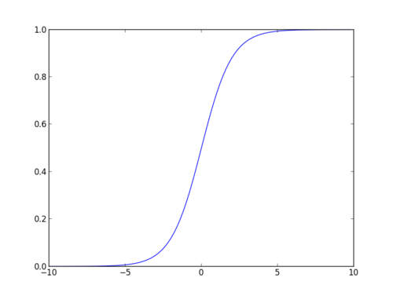
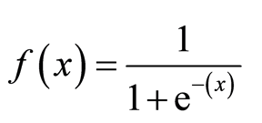

Slide 8



Linear Regression Equation:
Where, y is dependent variable and x1, x2 ... and Xn are explanatory variables.
Sigmoid Function:
Apply Sigmoid function on linear regression:

Slide 9
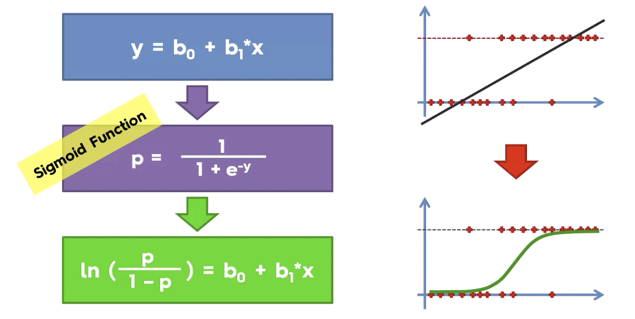

Slide 10
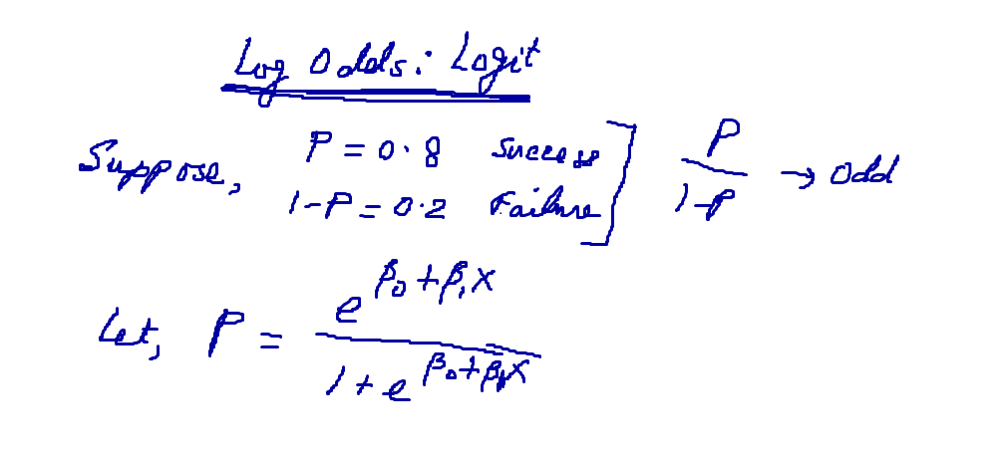

Slide 11
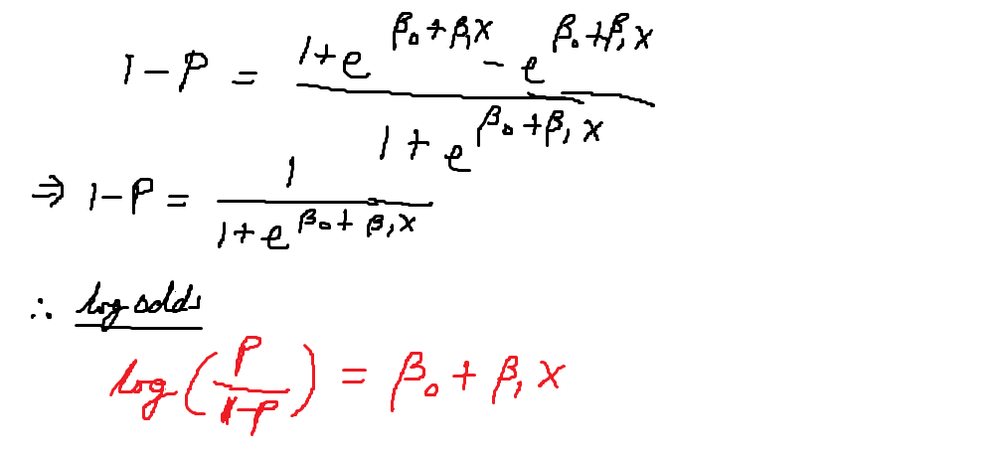

Slide 12
Properties of Logistic Regression:
The dependent variable in logistic regression follows Bernoulli Distribution.
Estimation is done through maximum likelihood.
No R Square; Model fitness is calculated through Concordance, KS-Statistics.

Slide 13
Linear Regression Vs. Logistic Regression
Linear regression gives you a continuous output, but logistic regression provides a constant output.
Linear regression is estimated using Ordinary Least Squares (OLS) while logistic regression is estimated using Maximum Likelihood Estimation (MLE) approach.

Slide 14
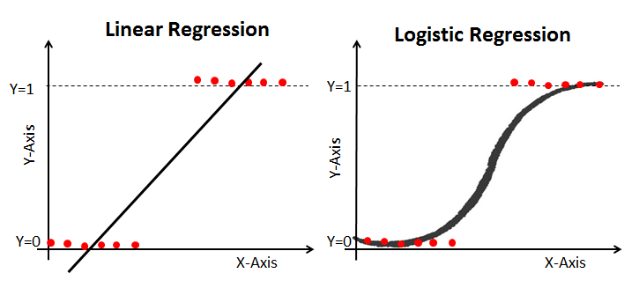

Slide 15
Types of Logistic Regression
Binary Logistic Regression: The target variable has only two possible outcomes such as Cancer or No Cancer.
Multinomial Logistic Regression: The target variable has three or more nominal categories such as predicting the type of Wine.
Ordinal Logistic Regression: the target variable has three or more ordinal categories such as product rating from 1 to 5.

Slide 16
Output in R
## Deviance Residuals: Min 1Q Median 3Q Max -1.6268 -0.8662 -0.6388 1.1490 2.0790 ## Coefficients: Estimate Std. Error z value Pr(>|z|) (Intercept) -3.989979 1.139951 -3.500 0.000465 *** gre 0.002264 0.001094 2.070 0.038465 * gpa 0.804038 0.331819 2.423 0.015388 * rank2 -0.675443 0.316490 -2.134 0.032829 * rank3 -1.340204 0.345306 -3.881 0.000104 *** rank4 -1.551464 0.417832 -3.713 0.000205 *** ## Null deviance: 499.98 on 399 degrees of freedom ## Residual deviance: 458.52 on 394 degrees of freedom ## AIC: 470.52

Slide 17
1- Each one-unit change in gre will increase the log odds of getting admit by 0.002, and its p-value indicates that it is somewhat significant in determining the admit.
2- Each unit increase in GPA increases the log odds of getting admit by 0.80 and p-value indicates that it is somewhat significant in determining the admit.
3- The difference between Null deviance and Residual deviance tells us that the model is a good fit. Greater the difference better the model. Null deviance is the value when you only have intercept in your equation with no variables and Residual deviance is the value when you are taking all the variables into account. It makes sense to consider the model good if that difference is big enough.

Slide 18
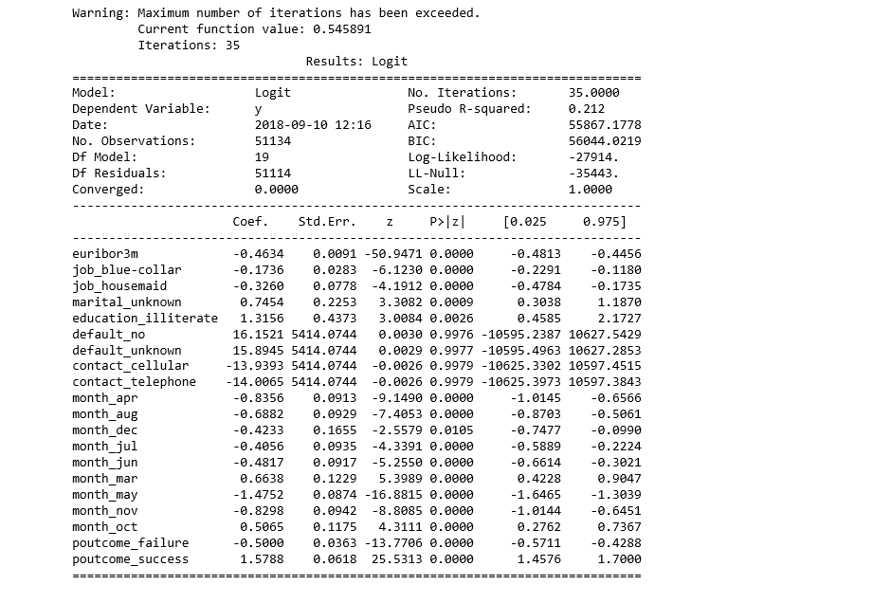

Slide 19

Hosmer-Lemeshow Test
It is used to determine the goodness of fit of the logistic regression model. Essentially it is a chi-square goodness of fit test for grouped data, usually where the data is divided into 10 equal subgroups.
where g = the number of groups. The test used is chi-square with g – 2 degrees of freedom. A significant test indicates that the model is not a good fit and a non-significant test indicates a good fit.

Slide 20
Classification Table
True Positives (TP) = the number of cases which were correctly classified to be positive, i.e. were predicted to be a success and were actually observed to be a success
False Positives (FP) = the number of cases which were incorrectly classified as positive, i.e. were predicted to be a success but were actually observed to be a failure
True Negatives (TN) = the number of cases which were correctly classified to be negative, i.e. were predicted to be a failure and were actually observed to be a failure
False Negatives (FN) = the number of cases which were incorrectly classified as negative, i.e. were predicted to be a negative but were actually observed to be a success

Slide 21

PP = predicted positive = TP + FP,
PN = predicted negative = FN + TN,
OP = observed positive = TP + FN,
ON = observed negative = FP + TN
Tot = the total sample size = TP + FP + FN + TN.

Slide 22
“pseudo” R²
Let L₀ be the value of the likelihood function for a model with no predictors, and let L_{M} be the likelihood for the model being estimated. McFadden’s R² is defined as
R²_{McF} = 1 – ln(L_{M)} / ln(L₀)
where ln(.) is the natural logarithm. The rationale for this formula is that ln(L₀) plays a role analogous to the residual sum of squares in linear regression. Consequently, this formula corresponds to a proportional reduction in “error variance”. It’s sometimes referred to as a “pseudo” R².

Slide 23
The Cox and Snell R²
R²_{C&S} = 1 – (L₀ / L_{M})^{2/n}
where n is the sample size. The rationale for this formula is that, for normal-theory linear regression, it’s an identity. In other words, the usual R² for linear regression depends on the likelihoods for the models with and without predictors by precisely this formula. It’s appropriate, then, to describe this as a “generalized” R² rather than a pseudo R² .

Slide 24
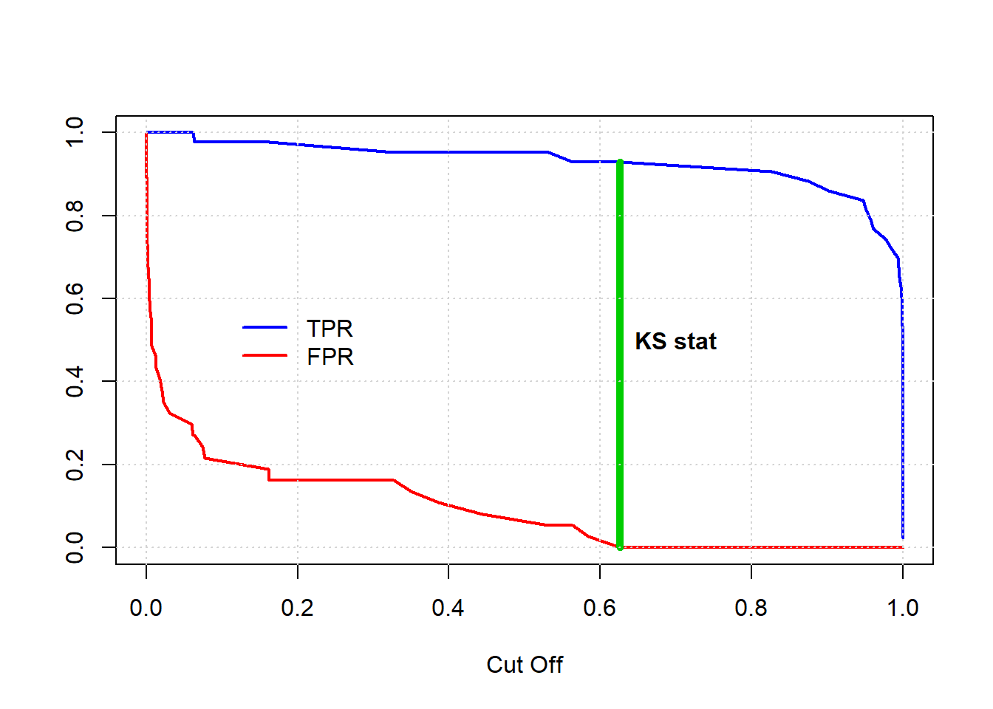

KS statistic
It is the maximum difference between TPR and FPR.
Higher KS stat value is indicative of better model. If we have more than one models, then KS statistics can be used as a performance measure.

Slide 25
AUC - ROC Curve
It is a performance measurement for classification problem at various thresholds settings. ROC is a probability curve and AUC represents degree or measure of separability. It tells how much model is capable of distinguishing between classes.

Slide 26
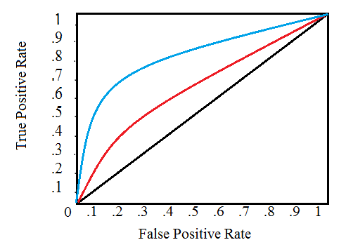

Slide 27
A ROC plot shows:
The relationship between sensitivity and specificity. For example, a decrease in sensitivity results in an increase in specificity.
Test accuracy; the closer the graph is to the top and left-hand borders, the more accurate the test. Likewise, the closer the graph to the diagonal, the less accurate the test. A perfect test would go straight from zero up the top-left corner and then straight across the horizontal.
The likelihood ratio; given by the derivative at any particular cut-point.

Slide 28


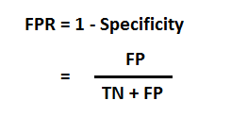
Defining terms used in AUC and ROC Curve

Slide 29
Relation between Sensitivity, Specificity, FPR
Sensitivity⬆, Specificity⬇ and Sensitivity⬇, Specificity⬆
TPR⬆, FPR⬆ and TPR⬇, FPR⬇

Slide 30
Maximum Likelihood Estimates
Suppose we have three data points this time and we assume that they have been generated from a process that is adequately described by a Gaussian distribution. These points are 9, 9.5 and 11. How do we calculate the maximum likelihood estimates of the parameter values of the Gaussian distribution μ and σ?

Slide 31
What we want to calculate is the total probability of observing all of the data, i.e., the joint probability distribution of all observed data points. To do this we would need to calculate some conditional probabilities, which can get very difficult. So, it is here that we’ll make our first assumption. The assumption is that each data point is generated independently of the others.

Slide 32
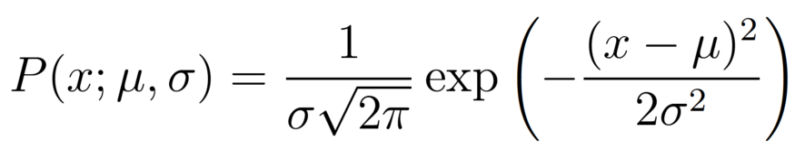
The probability density of observing a single data point x,

Slide 33
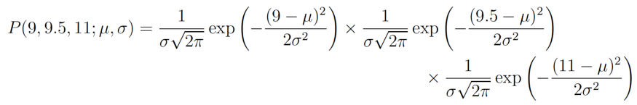
In our example the total (joint) probability density of observing the three data points is given by:

Slide 34
The log likelihood
We just have to figure out the values of μ and σ that results in giving the maximum value of the above expression.
The above expression for the total probability is quite a pain to differentiate, so it is almost always simplified by taking the natural logarithm of the expression. That is log likelihood.

Slide 35
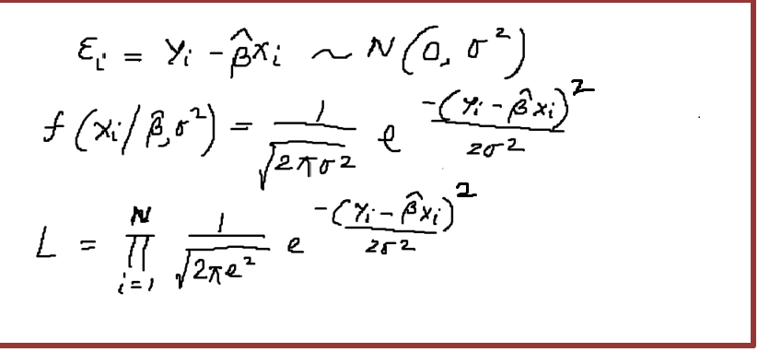
MLE generalized form

Slide 36
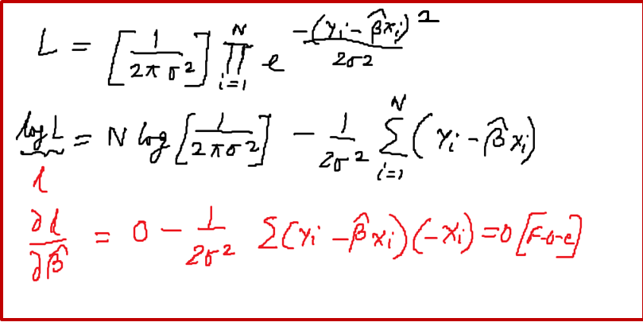

Slide 37
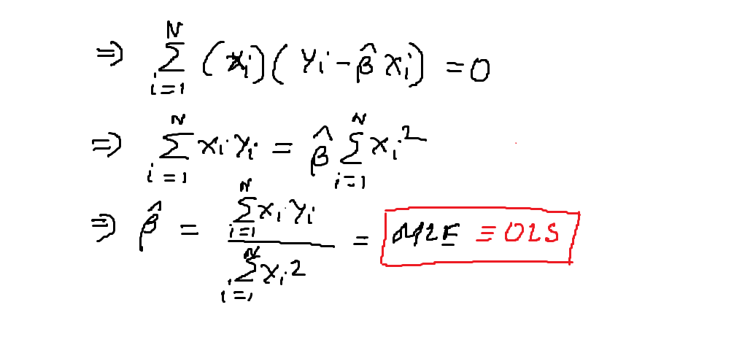

Slide 38
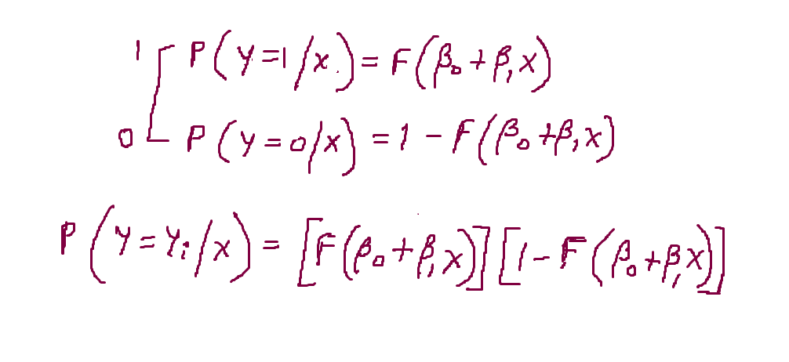
MLE for logit function

Slide 39
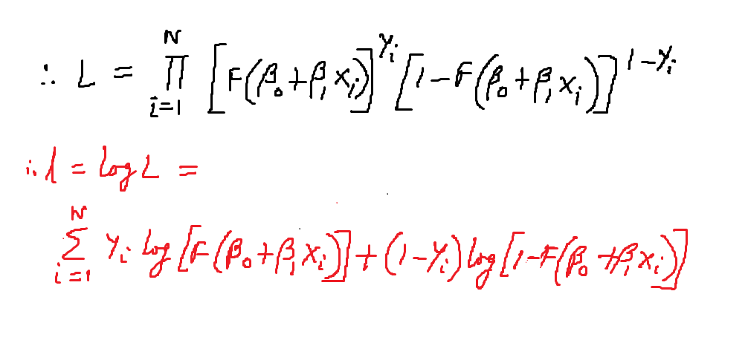

Slide 40
